Slide 1
Steps for Exam Success
THE LEC Presents

Slide 2
Some Logistics…
Exam times
7:50-9:30
Hour break
10:30-noon
Expectations
No additional time if late for exam
Bring permits to exam
Leave campus after tests are complete
No bathroom breaks during exams
Cell phones will be taken up
Extended Time
Classroom assignments will be communicated via email
2 hours and 15 min. to test (shorter break in between exams)

Slide 3
Enhancing Test Taking Confidence
1
2
3
Getting Organized
How to Study
Test Taking Strategies

Slide 4
Step One Getting Organized
1

Slide 5
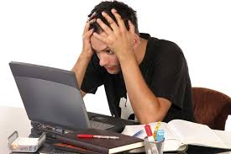
Planning
Keep in mind that your exams will cover information you learned during this semester. You will need to gather all notes, LAPs, etc. as you prepare.
The LEC 5-Day Backward Planning Rule: Calculate (at least) 5 days prior to your exam, and review your notes every night.

Slide 6
Dec. 9th | Dec. 10th | Dec. 11th | Dec. 12th | Dec. 13th | Dec. 14th | Dec. 15th
-Study for: Theology History | -Study for: Theology History | -Study for: Theology History | -Study for: Theology History English Math | -Study for: Theology History English Math | Theology History -Study for English Math Science Language | -Study for: English Math Science Language
Dec. 16th | Dec. 17th | Dec. 18th | Dec. 19th
-Study for: English Math Science Language | English Math -Study for: Science Language | Self-Help/Study Day -Study for: Science Language | Science Language
Notes:
The whole week leading up to the week of the 9th should be spent organizing materials.

Slide 7
ORGANIZING
Divide and conquer by having a printed version of each LAP attached to the corresponding notes and assignments.
Use the OBJECTIVES on the LAPs to begin reviewing and checking your understanding.
You need to know two different types of information: specific information and “Big Picture” information.
Specific Information
Flash Cards
Review often!
“Big Picture” Information
Read your notes in chunks organized by subject matter.
Organize the concepts into structures you can see (Venn diagram, Concept Map, T-Chart, Cornell Notes).
Review material with a classmate.
Organize The Material

Slide 8
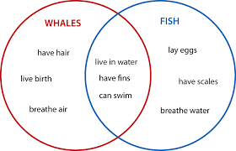
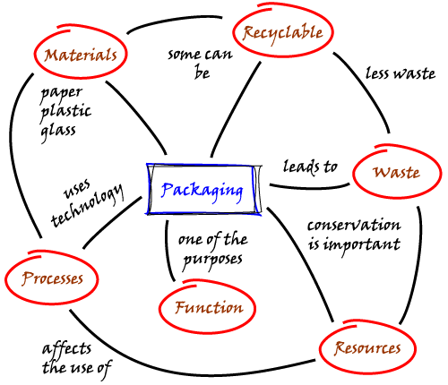
Concept Map
Venn Diagram

Slide 9
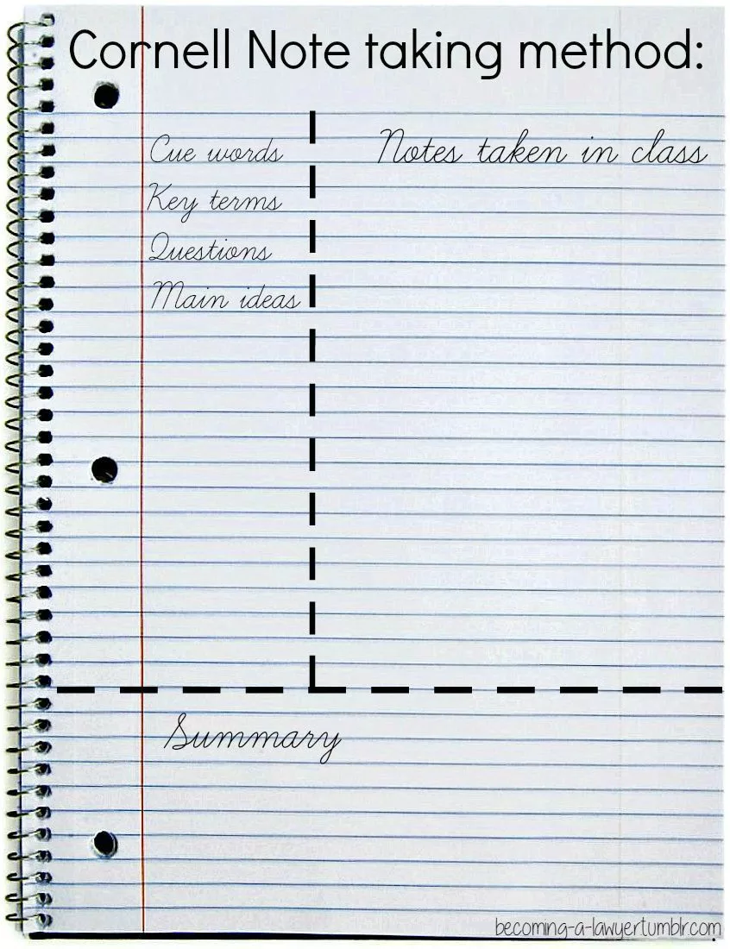

Slide 10
Collaboration
Explaining content material is a good way to reinforce what you know. The way your classmate describes material may help you develop your understanding. Make sure you have contact information for study-buddies in every class!

Slide 11
Step Two How to Study
2

Slide 12
Your CONCENTRATION!
Once you’ve organized the materials, you can focus on strengthening…

Slide 13
Concentrate!
30:10 RULE
Set a timer for 30 minutes (preferably not one on your phone).
STUDY until the timer goes off.
Set the timer for 10 minutes (max) break.
Your break should not involve screen time.
REPEAT.
We all have the ability to concentrate -- sometimes.
But at other times,
Your mind wanders from one thing to another.
Outside distractions take you away before you know it.
The material is boring, difficult, and/or not interesting to you.

Slide 14
Control This!
Study space
Stick to a routine, efficient study schedule
Focus
Manipulate study material
Vary your study activities
Take regular, scheduled breaks that fit your interests

Slide 15
SQ3R Study Strategy
Survey: Review the text to gain initial meaning from the headings, bolded text, and charts.
Question: Generate questions about the reading from previewing it.
Read: Look for answers to the questions you formulated during your preview of the text. These questions, based on the structure of the text, help focus your reading.

Slide 16
SQ3R Study Strategy
Recite: As you move through the text you should recite or rehearse the answers to your questions and make notes about your answer(s) for later studying.
Review: After reading, review the text to answer lingering questions and recite the questions you previously answered. Make note of material that needs to be reviewed again (see slide 6 about organization).

Slide 17
Step Three Test Taking Strategies
3

Slide 18
TRIAGE Method
How to ATTACK the Test
Preview the test.
Create a time schedule for each section based on your confidence level. Consider the following categories:
Probable = questions you can answer easily
Possible = questions you think you can work out the answer to
Long Shot = questions you have no idea how to answer

Slide 19
COMMON ERRORS
Failing to read and follow the instructions
Changing your first response
Failing to develop and follow a time schedule relative to the point value of each question
Reading more into the question than was written
Not reviewing the answers after completing the test
Answers should only be changed if you are certain you misunderstood the question/answer choices the first time

Slide 20
of TEST ANXIETY

Slide 21
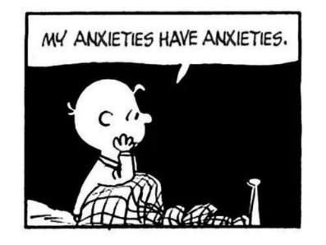
ABC of Test Anxiety
A = Activating Situation
B = Believe
C = Consequence of Anxiety
Notes:
For anxiety to occur, you must encounter a situation in which you may be harmed. A final exam is certainly an activating situation. You could fail and have to attend summer school. An even greater harm is that a test may cause you to feel unsuccessful in that subject area – few feelings are more damaging!
When you are anxious, you do not advance directly from A-C. The situation itself does not create anxiety. The mediating factor is B – what you BELIEVE about the consequences of the situation. To be able to avoid test anxiety, you must be in control of what you think. Show what you know – or Cause you to fail!
When you are anxious, your thought processes are diminished. On a test, you may not be able to recall facts, organize your thoughts, analyze and summarize information, or develop conclusions. You need all of these skills to perform well on a test.

Slide 22
Coping with Test Anxiety
Cause: You are unfamiliar with the test/ test format
Cures:
Learn about the test – ask questions before the exam
How many questions?
What will the format be?
What topics will be covered?
Practice demonstrating your understanding of the material in the same way you will on the test (for example, do practice problems in Math that look the same way the problems will look on your exam).

Slide 23
Restore Your Mind and Body
Healthy eating to improve memory and concentration (whole grains, salads with protein, fruit, dark chocolate)
Exercise
Prayer and
Meditation
Sleep
Self-talk
Journaling

Slide 24
Where to go for help…
Teachers
Classmates/study groups
Counselors
LEC staff
Director: Ms. Becker
Foreign Language Specialist: Fr. Dowalgo
Math Specialist: Mr. Fuchs*
Science Specialist: Dr. Spiering**
Writing Specialist: Ms. Speck
*Stop by the library to check availability
**Dr. Spiering will hold a Biology review session on Dec. 18th in room 5207 from 8:00-9:30

Slide 25
PRESS: Pre-Exam Study Sessions
What: An opportunity to review class material and learn study/test-taking skills directly from teachers
When: After school beginning Monday, Dec. 3 (see handout)
Why: To be even better prepared for your exams
*Note that students with a 75 or below in a class will be required to attend. Be sure to make a plan to attend each session so you don’t miss an opportunity for any one course.

Slide 26
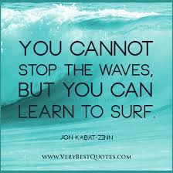
Good vibes!

